Slide 1
DOLI Quick Start – Child Labor Application Portal Guide

Slide 2

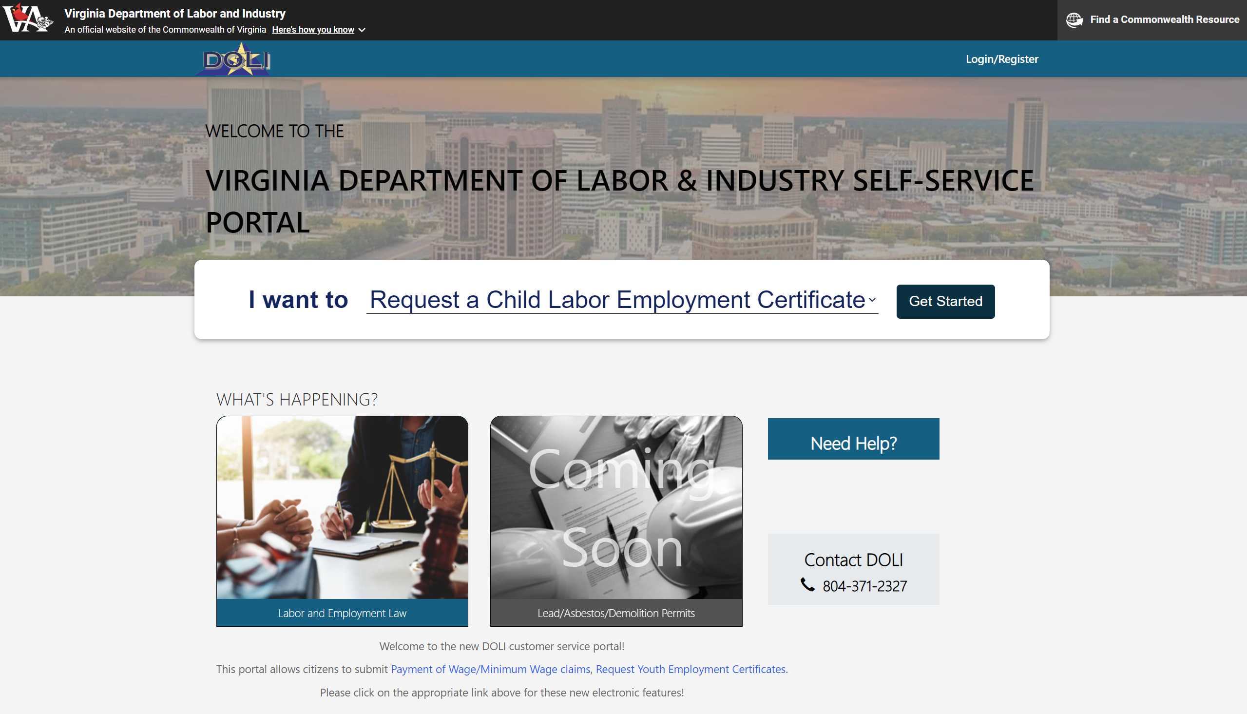
Youth Portion – Self Service Landing Page
Navigate to Labor & Employment Law by clicking photo tile or selecting "Request a Child Labor Employment Certificate" from the drop down
Notes:
Step 1: Youth Portion - Access Portal and Navigate to Youth Employment

Slide 3
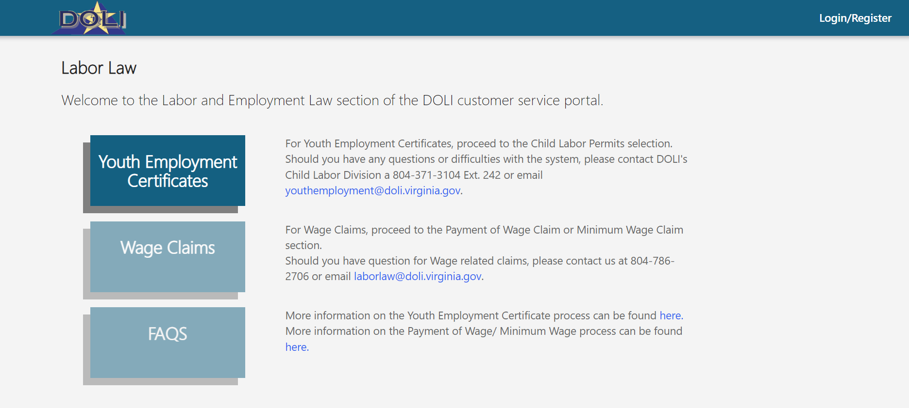
Youth Portion – Labor Law Page
2. Select Youth Employment Certificates
Notes:
Step 2: Navigate to Youth Application

Slide 4
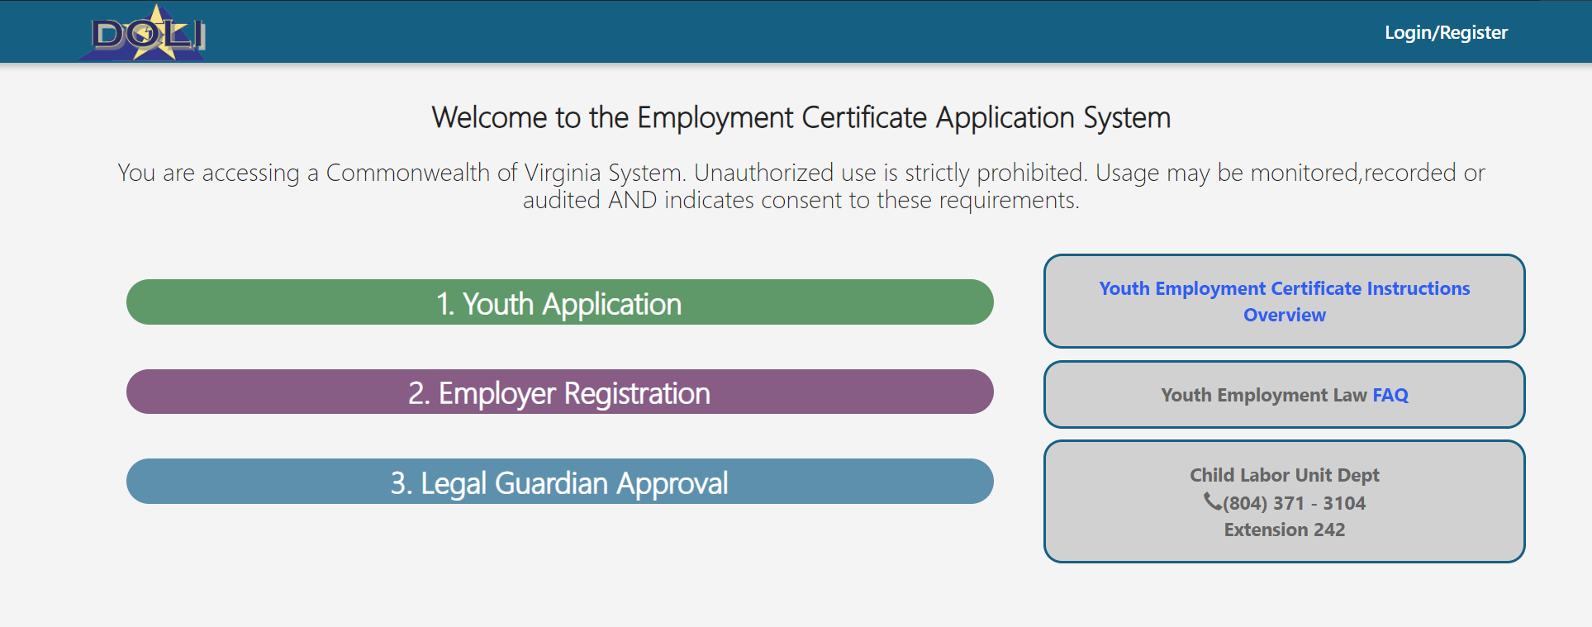
Youth Portion – Certificate Application Page
2. Select Youth Application to begin process
Note: This section should be completed by the youth desiring employment
Notes:
Step 2: Navigate to Youth Application

Slide 5
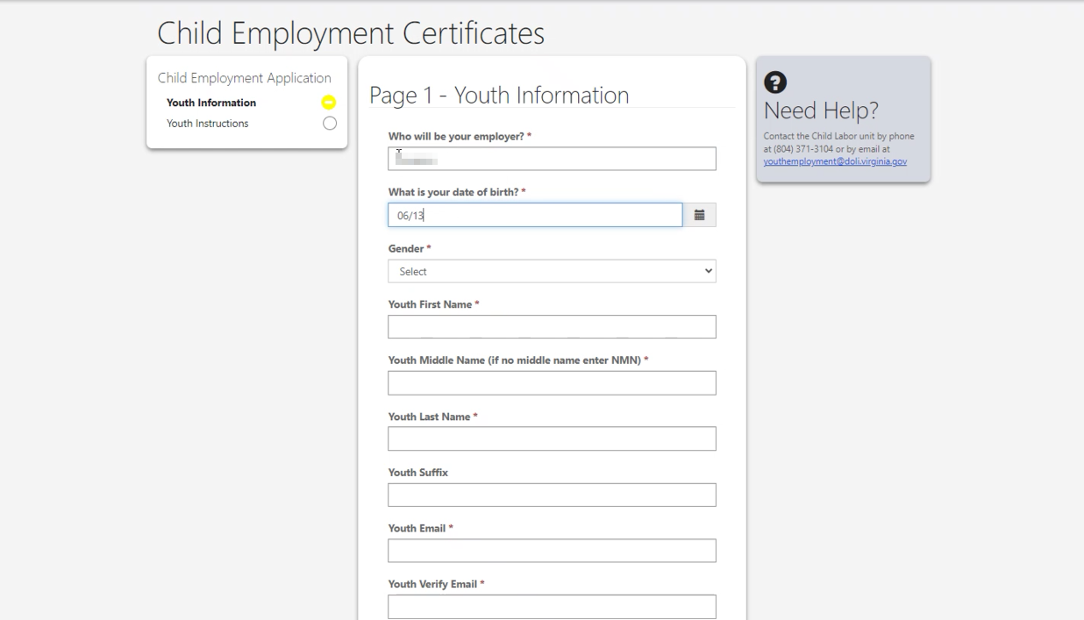
Youth Portion – Youth Application
3. Youth completes all fields, signs and submits
Notes:
Step 3: Complete Youth Application Form

Slide 6
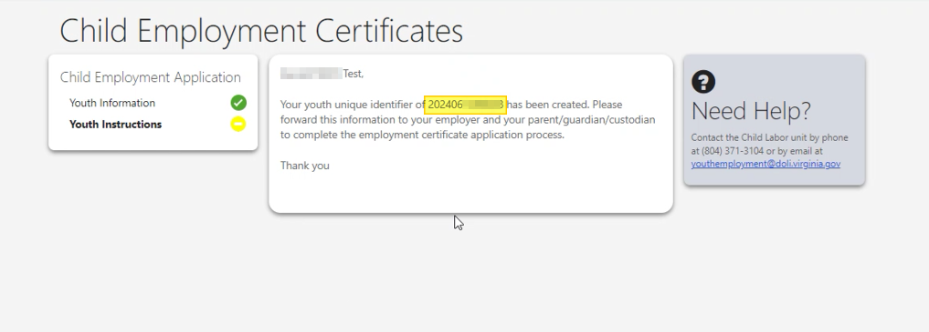
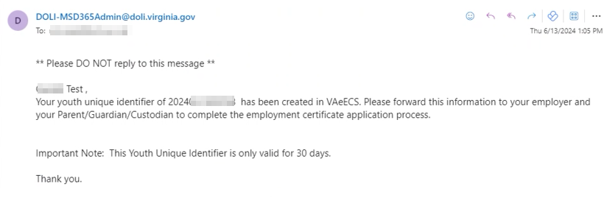
Youth Portion – Submission
4. Send Youth ID to Employer
A confirmation email will be sent to the registered email
Notes:
Step 4: Send Youth ID to Employer and receive confirmation email

Slide 7
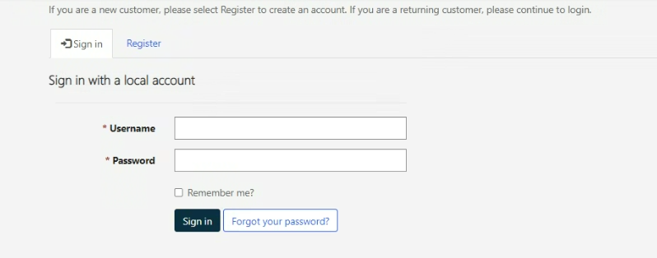
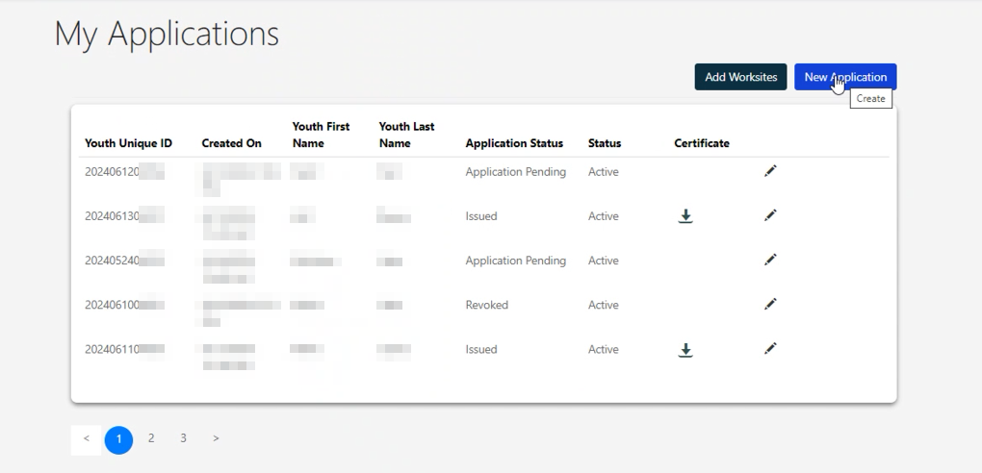
Employer Portion - Login
5. Employer accesses portal, logs in/registers and navigates to My Applications tab
Select New Application
Notes:
Step 5: Employer Portion – Employer Registers (if not registered) and Navigates to My Applications

Slide 8
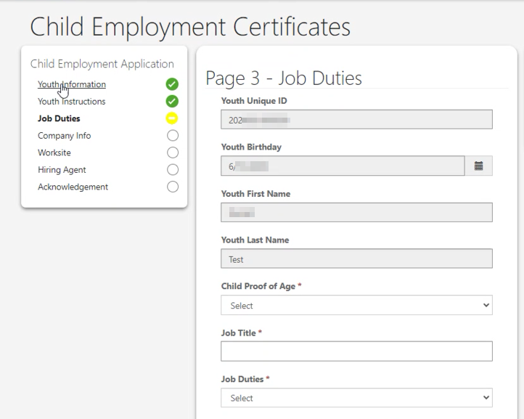
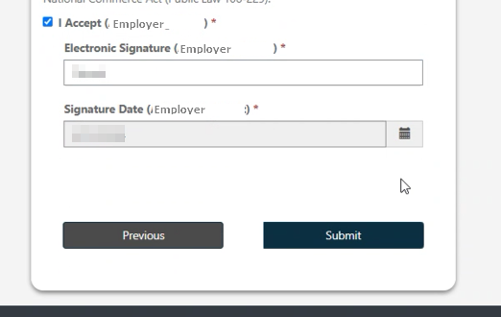
Employer Portion – Application Submission
7. Employer completes all fields, signs acknowledgement and submits.
Notes:
Step 5: Employer Portion -

Slide 9
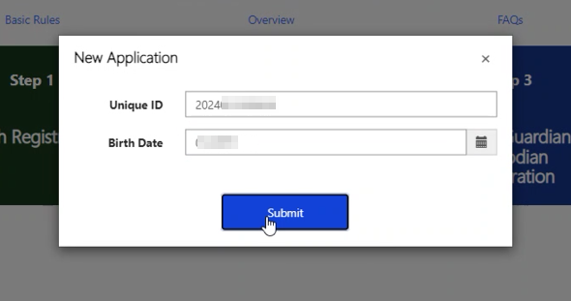
Employer Portion – Application Access
6. Employer enters Youth ID and Youth Birth Date
Notes:
Step 5: Employer Portion – Employer Registers (if not registered) and Navigates to My Applications

Slide 10
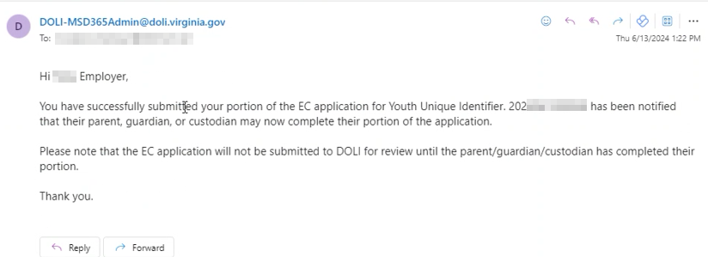
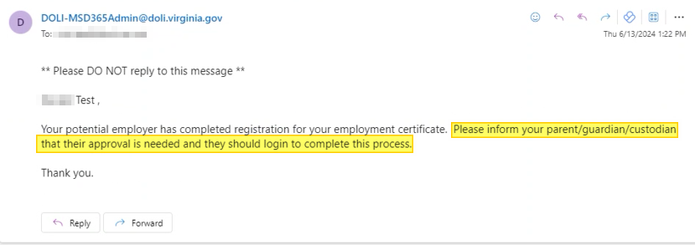
Employer Portion - Notification
8. Employer and Youth receive email notifications of Employer portion completion
Youth notifies legal guardian to complete their portion
Notes:
Step 5: Employer Portion -

Slide 11
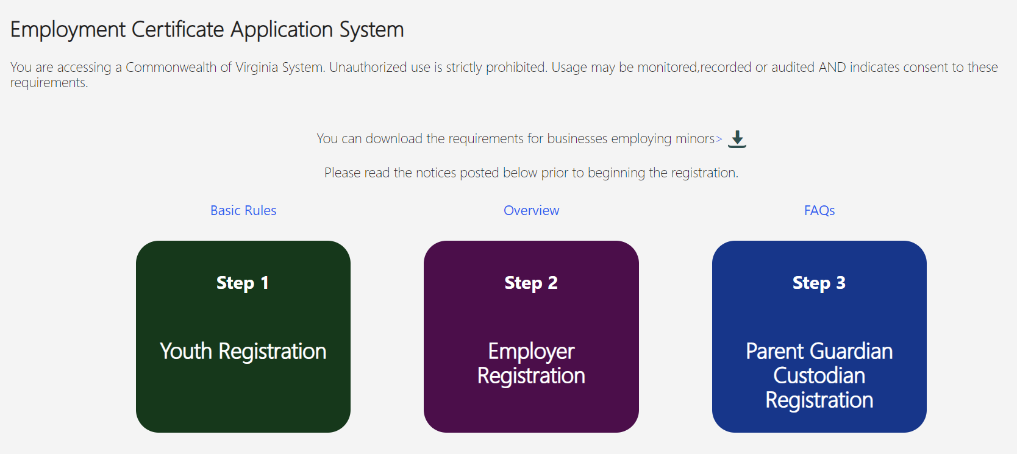
Authorizing Adult Portion – Application Access
9. Authorizing Adult accesses portal and selects Parent Guardian Custodian Registration
Adult enters Youth ID and Birth Date
Notes:
Step 5: Employer Portion -

Slide 12
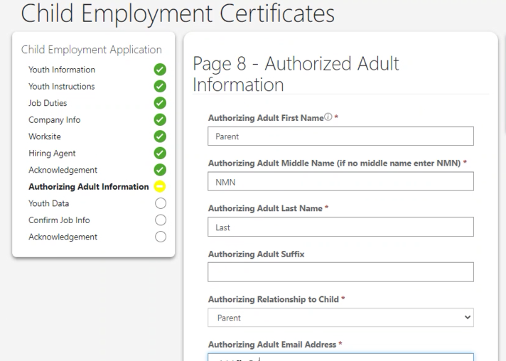
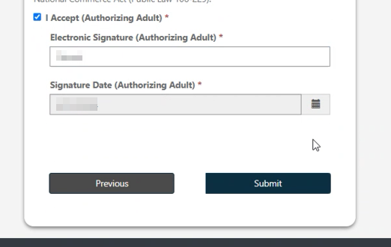
Authorized Adult Portion - Application
10. Authorized Adult completes all fields, signs acknowledgement and submits.
Notes:
Step 5: Employer Portion -

Slide 13
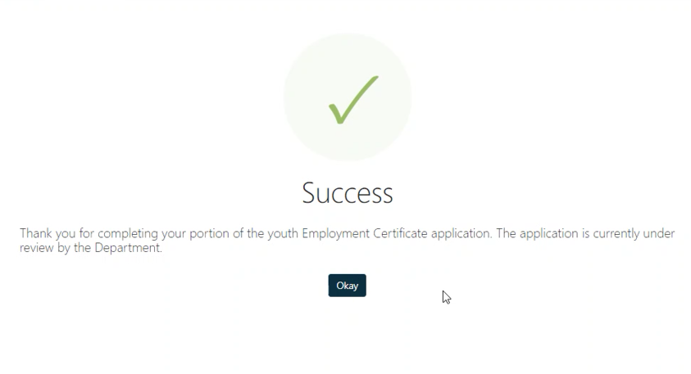
Submission Confirmation
11. Upon submission, Adult observes submission confirmation
Youth receives email notification of application completion
Notes:
Step 5: Employer Portion -

Slide 14
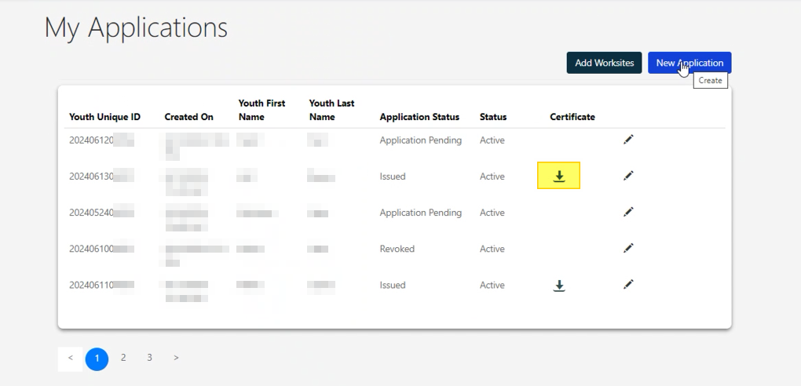
Certificate Download
12. Upon approval, Hiring Agent and Adult receive notification that certificate has been approved.
Employer logs in and navigates to My Applications
Click download icon to download certificate
Notes:
Step 5: Employer Portion -

Slide 15
804.371.3104 ext. 242
youthemployment@doli.virginia.gov

