Slide 1


Infectious Disease Prevention:
SARS-CoV-2 Virus That Causes COVID-19
16 VAC 25-220
EMERGENCY TEMPORARY STANDARD
Notes:
Based on COVID-19 Emergency Regulations – ETS – Infections Disease Prevention – SARS-CoV-2 and COVID-19 Regulation Language, Draft May 27 2020 for comment

Slide 2
DISCLAIMER
This guidance is not a standard or regulation, and it creates no new legal obligations. Refer to §16VAC25-220 for specific standard requirements.
The information provided is intended to assist employers in providing a safe and healthful workplace to employees.
Material contained in this publication is in the public domain and may be reproduced, fully or partially, without permission. Source credit is requested but not required.

Slide 3
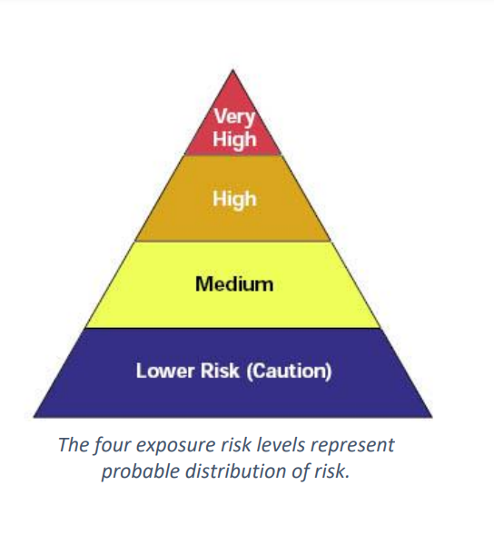
§10 Purpose & Applicability
Designed to establish requirements for employers to control, prevent, and mitigate the spread of SARS-CoV-2, the virus that causes coronavirus disease 2019 (COVID-19) to and among employees and employers.
Applies to every employer, employee, and place of employment in the Commonwealth of Virginia within the jurisdiction of the VOSH program as described in §§ 16VAC25-60-20 and 16VAC25-60-30.
Application of this standard to a place of employment is based on exposure risk level presented by SARS-CoV-2 virus-related and COVID-19 disease-related hazards present or job tasks undertaken by employees at the place of employment as defined in this standard as Very High, High, Medium, and Lower.

Slide 4
Determining Exposure Risk Level
Exposure Level
Job/Task
Presence of virus
# Employees /size of work area
Working distance between people
Duration / Frequency of Exposure
Presence of known or suspected COVID-19 person
The job tasks being undertaken;
The work environment (e.g. indoors or outdoors);
The known or suspected presence of the virus;
The presence of a person known or suspected to be infected with SARS-CoV-2 virus;
The number of employees and/or other persons in relation to the size of the work area;
The working distance between employees and other employees or person;
The duration and frequency of employee exposure though contact (inside of six feet) with other employees or persons (e.g., including shift work exceeding 8 hours per day);

Slide 5
Determining Exposure Risk Level
The type of hazards encounter, including potential exposure to the airborne transmission of SARS-CoV-2 virus;
Contact with contaminated surfaces or objects (tools, break room tables, rest rooms, workstations, entrances/exits, etc.);
Employer sponsored shared transportation is a common practice, such as ride-share vans or shuttle vehicles, car-pools, etc.

Slide 6
Compliance
This standard shall not conflict with requirements and guidelines applicable to businesses set out in any applicable Virginia executive order or order of public health emergency.
To the extent that an employer actually complies with a recommendation contained in CDC guidelines, whether mandatory or non-mandatory to mitigate SARS-CoV-2 virus and COVID-19 related hazards or job tasks addressed by this standard, and provided that the CDC recommendation provides equivalent or greater protection than provided by a provision of this standard, the employer’s actions shall be considered in compliance with this standard.

Slide 7
Compliance
An employer's actual compliance with a recommendation contained in CDC guidelines, whether mandatory or non-mandatory, to mitigate SARS-COV-2 and COVID19 related hazards or job tasks addressed by this standard shall be considered evidence of good faith in any enforcement proceeding related to this standard.

Slide 8
Compliance – Education
Public and private institutions of higher education that have received certification from the State Council of Higher Education of Virginia that their re-opening plans are in compliance with guidance documents, whether mandatory or non-mandatory, developed by the Governor’s Office in conjunction with the Virginia Department of Health shall be considered in compliance with this standard, provided the institution operates in compliance with their certified reopening plans and the certified reopening plans provide equivalent or greater levels of employee protection than this standard.

Slide 9
Compliance - Education
Public school divisions and private schools that submit their plans to the Virginia Department of Education to move to Phase II and Phase III that are aligned with CDC guidance for reopening of schools that provide equivalent or greater levels of employee protection than a provision of this standard and who operate in compliance with the public school division’s or private school's submitted plans shall be considered in compliance with this standard.
An institution’s actual compliance with recommendations contained in CDC guidelines or the Virginia Department of Education guidance, whether mandatory or non-mandatory, to mitigate SARS-COV-2 and COVID19 related hazards or job tasks addressed by this standard shall be considered evidence of good faith in any enforcement proceeding related to this standard.

Slide 10

Contact Tracing
Nothing in the standard shall be construed to require employers to conduct contact tracing of the SARS-CoV-2 virus or COVID-19 disease

Slide 11

§20 Dates
Effective and Expiration Date:
Effective immediately upon publication in a newspaper of general circulations published in the City of Richmond.
Expires within six months of its effective date, or
Upon expiration of the Governor’s State of Emergency, or
When superseded by a permanent standard, whichever occurs first, or
When repealed by the Virginia Safety and Health Codes Board.

Slide 12
§20 Dates
Training Dates:
With the exception of §16VAC25-220-80.B.10 regarding training required on infectious disease preparedness and response plans, the training requirements in §16VAC25-220-80 shall take effect thirty (30) days after the effective date of this standard.
The training requirements under §16VAC25-220-80.B.10 shall take effect sixty (60) days after the effective date of this standard.
The requirements for §16VAC25-220-70, Infectious Disease Preparedness and Response Plan, shall take effect sixty (60) days after the effective date of this standard.

Slide 13
§30 Important Definitions
Administrative Control means any procedure which significantly limits daily exposure to SARS-CoV-2 virus and COVID-19 disease related workplace hazards and job tasks by control or manipulation of the work schedule or manner in which work is performed. The use of personal protective equipment is not considered a means of administrative control.
Asymptomatic means a person who does not have symptoms.
Building/facility owner means the legal entity, including a lessee, which exercises control over management and record keeping functions relating to a building and/or facility in which activities covered by this standard take place.
Cleaning means the removal of dirt and impurities, including germs, from surfaces. Cleaning alone does not kill germs. But by removing the germs, it decreases their number and therefore any risk of spreading infection.

Slide 14

§30 Important Definitions
COVID-19 means Coronavirus Disease 2019, which is primarily a respiratory disease caused by the SARS-CoV-2 virus.
Disinfecting means using chemicals approved for use against SARS-CoV-2, for example, EPA-registered disinfectants, to kill germs on surfaces. This process does not necessarily clean dirty surfaces or remove germs. But killing germs remaining on a surface after cleaning further reduces any risk of spreading infection.

Slide 15
§30 Important Definitions
Duration and frequency of employee exposure means how long (“duration”) and how often (“frequency”) an employee is potentially exposed to the SARS-CoV-2 or COVID-19 disease. Generally, the greater the frequency or length of exposure, the greater the probability is for potential infection to occur.
Frequency of exposure is generally more significant for acute acting agents or situations, while duration of exposure is generally more significant for chronic acting agents or situations.
An example of an acute situation would be an unprotected customer, patient, or other person coughing or sneezing directly into the face of an employee.
An example of a chronic situation would be a job task that requires an employee to interact either for an extended period of time inside six feet with a smaller static group of other employees or persons; or for an extended period of time inside six feet with a larger group of other employees or persons in succession but for periods of shorter duration.

Slide 16
§30 Important Definitions
Economic Feasibility means the employer is financially able to undertake the measures necessary to comply with one or more requirements in this standard. The cost of corrective measures to be taken will not usually be considered as a factor in determining whether a violation of this standard has occurred. If an employer’s level of compliance lags significantly behind that of its industry, an employer’s claim of economic infeasibility will not be accepted.
Elimination means a method of exposure control that removes the employee completely from exposure to SARS-CoV-2 virus and COVID-19 disease related workplace hazards and job tasks.

Slide 17
§30 Important Definitions
Employee means an employee of an employer who is employed in a business of his employer. Reference to the term “employee” in this standard also includes, but is not limited to, temporary employees and other joint employment relationships, as well as persons in supervisory or management positions with the employer, etc., in accordance with Virginia occupational safety and health laws, standards, regulations, and court rulings.
Engineering control means the use of substitution, isolation, ventilation, and equipment modification to reduce exposure to SARS-CoV-2 virus and COVID-19 disease related workplace hazards and job tasks.

Slide 18
§30 Important Definitions
Exposure risk level means an assessment of the possibility that an employee could be exposed to the hazards associated with SARS-CoV-2 virus and the COVID-19 disease. The exposure risk level assessment should address all risks and all modes of transmission including airborne transmission, as well as transmission by asymptomatic and presymptomatic individuals. Risk levels should be based on the risk factors present that increase risk exposure to COVID -19 and are present during the course of employment regardless of location.
Hazards and job tasks have been divided into four risk exposure levels
“very high”, “high”, “medium”, and “lower”:

Slide 19
Levels of Risk
Very High - exposure risk hazards or job tasks are those in places of employment with high potential for employee exposure to known or suspected sources of the SARS-CoV-2 virus (e.g., laboratory samples) or persons known or suspected to be infected with SARS-CoV-2 virus, including, but not limited to, during specific medical, postmortem, or laboratory procedures:
Notes:
4 Levels of Risk

Slide 20

Examples of “VERY HIGH” risk level include
Aerosol-generating procedures (e.g., intubation, cough induction procedures, bronchoscopies, some dental procedures and exams, or invasive specimen collection) on patient or person known or suspected to have COVID-19;
Collecting or handling specimens from a patient or person known or suspected to have COVID-19 (e.g., manipulating cultures from patients known or suspected to have COVID-19 patients);
Performing an autopsy, that involves aerosol-generating procedures, on the body of a person known to have, or suspected of having, COVID-19 at the time of their death.
Notes:
This is not an all inclusive list

Slide 21
Levels of Risk
High - exposure risk hazards or job tasks are those in places of employment with high potential for employee exposure inside six feet with known or suspected sources of SARS-CoV-2, or person known or suspected to be infected with SARS-CoV-2 virus that are not otherwise classified as “very high” exposure risk including, but not limited to:
Notes:
4 Levels of Risk

Slide 22
Examples of “HIGH” risk level include
Healthcare - (physical and mental) delivery and support services provided to a patient known or suspected to be infected with SARS-CoV-2 virus, including field hospitals (e.g., doctors, nurses, cleaners, and other hospital staff who must enter patient rooms or areas).
Healthcare - (physical and mental) delivery, care, and support services, wellness services, non-medical support services, physical assistance, etc., provided to a patient, resident, or other person known or suspected to be infected with SARS-SoV-2 involving:
Skilled nursing services,
Outpatient medical services,
Clinical services,
Drug treatment programs,
Medical outreach services,
Mental health services,
Home health care,
Nursing home care,
Assisted living care,
Memory care support and services,
Hospice care,
Rehabilitation services,
Primary and specialty medical care,
Dental care,
COVID-19 testing services,
Blood donation services,
Contact tracer services,
Chiropractic services;

Slide 23
Examples of “HIGH” risk level include
First responder services provided to a patient, resident, or other person known or suspected to be infected with SARS-CoV-2;
Medical transport services (loading, transporting, unloading, etc.) provided to patients known or suspected to be infected with SARS-CoV-2 (e.g., ground or air emergency transport, staff, operators, drivers, pilots, etc.);
Mortuary services involved in preparing (e.g., for burial or cremation) the bodies of persons who are known to have, or suspected of being infected with SARS-CoV-2 at the time of their death.

Slide 24
Levels of Risk
Medium - exposure risk hazards or job tasks are those not otherwise classified as “very high” or “high” exposure risk in places of employment that require more than minimal occupational contact inside six feet with other employees, other persons, or the general public who may be infected with SARS-CoV-2, but who are not known or suspected to be infected with the virus. “Medium” exposure risk hazards or job tasks may include, but are not limited to, operations and services in:
Notes:
4 Levels of Risk

Slide 25
Examples of “Medium” risk level may include
Poultry, meat, and seafood processing
Agricultural and hand labor
Commercial transportation of passengers by air/land/water
On campus educational settings in schools, colleges, and universities
Daycare and afterschool settings
Restaurants and bars
Grocery stores, convenience store, and food banks
Drug stores and pharmacies
Manufacturing settings
Indoor and outdoor construction settings
Correctional facilities, jails, detentions centers, and juvenile detention centers
Work performed in customer premises, such as homes or businesses;
Retail stores
Call centers
Package processing settings
Veterinary settings
Personal care, personal grooming, salon, and spa settings
Venues for sports, entertainment, movie theater, and other forms of mass gatherings
Homeless shelters
Fitness, gym, and exercise facilities
Airports, and train and bus stations

Slide 26
Examples of “Medium” risk level may include
Situations not involving exposure to known or suspected sources of SARS-CoV-2:
Hospitals
Other healthcare (Physical & Mental) Delivery & Support in a non-hospital setting
Wellness services
Physical assistance
Skilled nursing facilities
Outpatient medical facilities
Clinics
Drug treatment programs
Medical outreach service
Non-medical support services
Mental health facilities
Home health care
Nursing homes
Assisted living facilities
Memory Care Facilities
Hospice Care
Rehabilitation Centers
Doctor and Dentist offices
Chiropractors’ offices
First Responder Services provided by police, fire, paramedic and emergency medical services providers
Medical Transport
Contract Tracers
Etc.

Slide 27
Lower Levels of Risk
Lower exposure risk hazards or job tasks are those not otherwise classified as “very high”, “high”, or “medium” exposure risk that do not require contact inside six feet with persons known to be, or suspected of being, or who may be infected with SARS-CoV-2.
Employees in this category have minimal occupational contact with other employees, other persons, or the general public, such as in an office building setting; or are able to achieve minimal occupational contact through the implementation of engineering, administrative and work practice controls, such as, but not limited to:
Notes:
4 Levels of Risk

Slide 28
Achieve Minimal Occupational Contact Through Work Practice Controls
Installation of floor to ceiling physical barriers constructed of impermeable material and not subject to unintentional displacement (e.g., such as clear plastic walls at convenience stores behind which only one employee is working at any one time);
Telecommuting;
Staggered work shifts that allow employees to maintain physical distancing from other employees, other persons, and the general public;
Delivering services remotely by phone, audio, video, mail, package delivery, curbside pickup or delivery, etc., that allows employees to maintain physical distancing from other employees, other persons, and the general public; and

Slide 29
Work Practice Controls
Mandatory physical distancing of employees from other employees, other persons, and the general public.
Employee use of face coverings for contact inside six feet of coworkers, customers, or other persons is not an acceptable administrative or work practice control to achieve minimal occupational contact. However, when it is necessary for brief contact with others inside the 6 feet distance a face covering is required.

Slide 30
Important Definitions
Face covering means an item normally made of cloth or various other materials with elastic bands or cloth ties to secure over the wearer’s nose and mouth in an effort to contain or reduce the spread of potentially infectious respiratory secretions at the source (i.e., the person’s nose and mouth).
A face covering is not intended to protect the wearer, but it may reduce the spread of virus from the wearer to others.
A face covering is not a surgical/medical procedure mask.
A face covering is not subject to testing and approval by a state or government agency, so it is not considered a form of personal protective equipment or respiratory protection equipment under VOSH laws, rules, regulations, and standards.

Slide 31

Important Definitions
Feasible as used in this standard includes both technical and economic feasibility.
Filtering facepiece respirator means negative pressure air purifying particulate respirator with a filter as an integral part of the facepiece or with the entire facepiece composed of the filtering medium. These are certified for use by the National Institute for Occupational Safety and Health (NIOSH).
Hand sanitizer means an alcohol-based hand rub containing at least 60% alcohol, unless otherwise provided for in this standard.

Slide 32
Important Definitions
Known to be infected with the SARS-CoV-2 virus means a person, whether symptomatic or asymptomatic, who has tested positive for SARS-CoV-2 and the employer knew or with reasonable diligence should have known that the person has tested positive for SARS-Cov-2.
May be infected with SARS-CoV-2 virus means any person not currently a person known or suspected to be infected with SARS-CoV-2 virus, and not currently vaccinated against SARS-CoV-2 virus.
Occupational exposure means the state of being actually or potentially exposed to contact with SARS-CoV-2 virus or COVID-19 disease-related hazards at the work location or while engaged in work activities at another location.

Slide 33
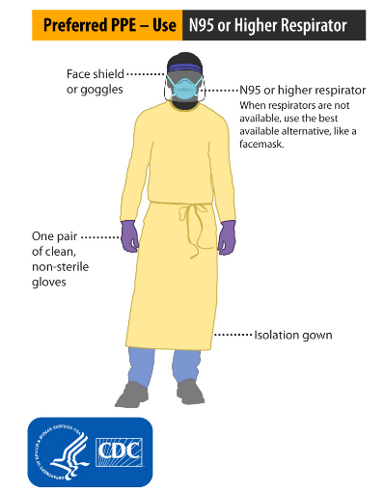
Important Definitions
Personal protective equipment means equipment worn to minimize exposure to hazards that cause serious workplace injuries and illnesses. These injuries and illnesses may result from contact with chemical, radiological, physical, electrical, mechanical, biological or other workplace hazards. Personal protective equipment may include, but is not limited to items such as gloves, safety glasses, shoes, earplugs or muffs, hard hats, respirators, surgical/medical procedure masks, coveralls, vests, and full body suits.

Slide 34
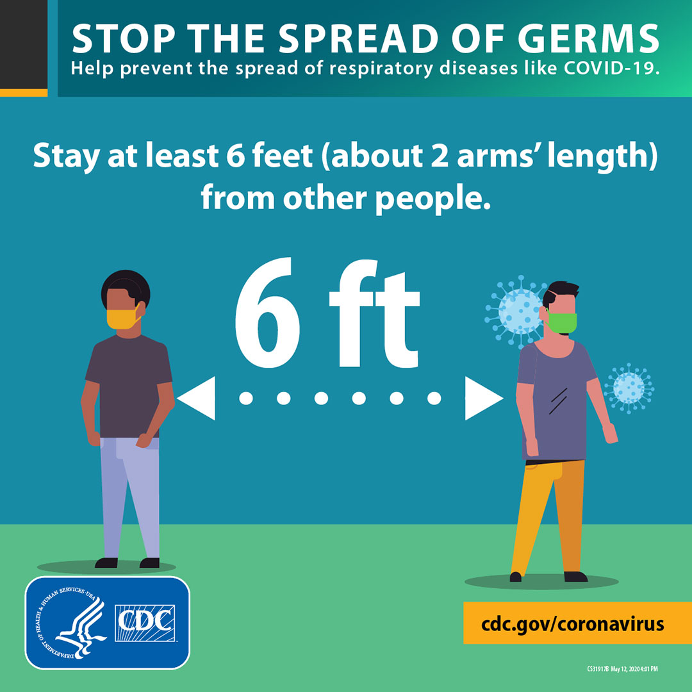
Important Definitions
Physical distancing also called “social distancing” means keeping space between yourself and other persons while conducting work-related activities inside and outside of the physical establishment by staying at least 6 feet from other persons.
Physical separation of an employee from other employees or persons by a permanent, solid floor to ceiling wall constitutes physical distancing from an employee or other person stationed on the other side of the wall.

Slide 35
Important Definitions
Respirator means a protective device that covers the nose and mouth or the entire face or head to guard the wearer against hazardous atmospheres. Respirators are certified for use by the National Institute for Occupational Safety and Health (NIOSH).
Respirators may be:
Tight-fitting, that is, half masks, which cover the mouth and nose and full face pieces that cover the face from the hairline to below the chin; or
Loose-fitting, such as hoods or helmets that cover the head completely.
In addition, there are two major classes of respirators:
Air-purifying, which remove contaminants from the air; and
Atmosphere-supplying, which provide clean, breathable air from an uncontaminated source. As a general rule, atmosphere-supplying respirators are used for more hazardous exposures.

Slide 36
Important Definitions
Respirator user means an employee who in the scope of their current job may be assigned to tasks which may require the use of a respirator in accordance with this standard or required by other provisions in the VOSH/OSHA standards.
SARS-CoV-2 means a betacoronavirus, like MERS-CoV and SARS-CoV. Coronaviruses are named for the crown-like spikes on their surface. The SARS-CoV-2 causes what has been designated as the Coronavirus Disease 2019 (COVID-19).
Signs of COVID-19 include trouble breathing, persistent pain or pressure in the chest, new confusion, inability to wake or stay awake, bluish lips or face, etc.

Slide 37
Important Definitions
Surgical/Medical procedure mask means a mask to be worn over the wearer’s nose and mouth that is:
Fluid resistant and provides the wearer protection against large droplets, splashes, or sprays of bodily or other hazardous fluids, and prevents the wearer from exposing others in the same fashion;
It protects others from the wearer’s respiratory emissions;
It has a loose fitting face seal and it does not provide the wearer with a reliable level of protection from inhaling smaller airborne particles.
It is considered a form of personal protective equipment but is not considered respiratory protection equipment under VOSH laws, rules, regulations, and standards.
Testing and approval is cleared by the U.S. Food and Drug Administration (FDA).

Slide 38
Important Definitions
Suspected to be infected with SARS-CoV-2 virus means a person that has signs or symptoms is COVID-19 but has not tested positive for SARS-CoV-2 and no alternative diagnosis has been made.
Symptomatic means the employee is experiencing symptoms similar to those attributed to COVID-19 including fever or chills, cough, shortness of breath or difficulty breathing, fatigue, muscle or body aches, headache, sore throat, new loss of taste or smell, congestion or runny nose, nausea or vomiting, or diarrhea.
Symptoms may appear in 2 to 14 days after exposure to the virus.

Slide 39
Important Definitions
Technical feasibility means the existence of technical know-how as to materials and methods available or adaptable to specific circumstances which can be applied to one or more requirements in this standard with a reasonable possibility that employee exposure to SARS-CoV-2 and COVID-19 hazards will be reduced. If an employer’s level of compliance lags significantly behind that of their industry, allegations of technical infeasibility will not be accepted.
Work practice control means a type of administrative control by which the employer modifies the manner in which the employee performs assigned work. Such modification may result in a reduction of exposure through such methods as changing work habits, improving sanitation and hygiene practices, or making other changes in the way the employee performs the job.

Slide 40
§40 A. Mandatory Requirements – All Employers
Employers in all exposure risk levels shall ensure compliance with the following requirements to protect employees from workplace exposure to the SARS-CoV-2 virus that causes the COVID-19 disease:
Assess their workplace for hazards and job tasks that can potentially expose employees to the SARS-CoV-2 virus.
Classify each job task according to the hazards employees are potentially exposed to and ensure compliance with applicable sections of this standard for very high, high, medium, or lower risk levels of exposure.
Tasks that are similar in nature and expose employees to the same hazard may be grouped for classification purposes.
Employers shall inform and encourage employees to self-monitor for signs and symptoms if they suspect possible exposure or are experiencing signs of an oncoming illness.

Slide 41
§40 Mandatory Requirements – All Employers
Serological testing, also known as antibody testing, is a test to determine if persons have been infected with SARS-CoV-2 virus. It has not been determined if persons who have the antibodies are immune from infection.
Serologic test results shall not be used to make decisions about returning employees to work who were previously classified as known or suspected to be infected with the SARS-CoV-2 virus.
Serologic test results shall not be used to make decisions concerning employees that were previously classified as known or suspected to be infected with the SARS-CoV-2 virus about grouping, residing in or being admitted to congregate settings, such as schools, dormitories, etc.

Slide 42
§40 Mandatory Requirements – All Employers
Develop and implement policies and procedures for employees to report when they are experiencing symptoms consistent with COVID-19 and no alternative diagnosis has been made.
Such employees shall be designated by the employer as “suspected to be infected with SARS-CoV-2 virus.”
Employers shall not permit employees or other persons known or suspected to be infected with SARS-CoV-2 virus to report to or remain at the work site or engage in work at a customer or client location until cleared for return to work (see §16VAC25-220-40.B ).

Slide 43
Mandatory Requirements
Nothing in this standard shall prohibit an employer from permitting an employee known or suspected to be infected with SARS-CoV-2 virus from engaging in teleworking or other form of work isolation that would not result in potentially exposing other employees to the SARS-CoV-2 virus.
To the extent feasible and permitted by law, including but not limited to the Families First Coronavirus Response Act, employers shall ensure that sick leave policies are flexible and consistent with public health guidance and that employees are aware of these policies.

Slide 44

Contract/Temporary Workers Mandatory Requirements
Employers shall discuss with subcontractors, and companies that provide contract or temporary employees about the importance of employees or other persons who are known or suspected to be infected with the SARS-CoV-2 virus staying home.
Known or suspected to be infected subcontractor, contract, or temporary employees shall not report to or be allowed to remain at the work site until cleared for return to work.
Subcontractors shall not allow their known or suspected to be infected employees to report to or be allowed to remain at work or on a job site until cleared for return to work

Slide 45
Notification of Positive Test
To the extent permitted by law, including HIPPA, employers shall establish a system to receive reports of positive SARS-CoV-2 tests by employees, subcontractors, contract employees, and temporary employees (excluding patients hospitalized on the basis of being know or suspected to be infected) present at the place of employment within the previous 14 days from the date of positive test, and the employer shall notify:
Its own employees who may have been exposed, within 24 hours of discovery of their possible exposure while keeping confidential the identity of the known to be infected person in accordance with the requirements of the Americans with Disabilities Act (ADA) and other applicable federal and Virginia laws and regulations; and
In the same manner as §16VAC25-220-40.A.8.a, other employers whose employees were present at the work site during the same time period; and

Slide 46
Notification of Positive Test
The building/facility owner. The building/facility owner will require all employer tenants to notify them of the occurrence of a SARS-CoV-2 positive test for any employees or residents in the building.
The building/facility owner will take the necessary steps to sanitize the common areas of the building.
The building/facility owner will notify all employer tenants in the building that one or more cases have been discovered and the floor or work area where the case was located.
The identity will be kept confidential.
The Virginia Department of Health within 24 hours of the discovery of a positive case.
The Virginia Department of Labor and Industry within 24 hours of the discovery of three (3) or more employees present at the place of employment within a 14-day period testing positive for SARS-CoV-2 during that 14-day time period.

Slide 47
Exposure and Medical Records Access
Employers shall ensure employee access to their own SARS-CoV-2 and COVID-19 related exposure and medical records in accordance with the standard applicable to its industry.
Employers in the agriculture, public sector marine terminal, and public sector longshoring industries shall ensure employees access to their own SARS-CoV-2 and COVID-19 related exposure and medical records in accordance with 1910.1020.

Slide 48
§40 B. Return to Work
The employer shall develop and implement policies and procedures for known or suspected to be infected employees to return to work using either a symptom-based or test-based strategy depending on local healthcare and testing circumstances
While an employer may rely on other reasonable options, a policy that involves consultation with appropriate healthcare professionals concerning when an employee has satisfied the symptoms based strategy requirements in §16VAC25-220-40.B.1.a will constitute compliance with the requirements of §16VAC25-220-40.B.

Slide 49
System and Test Based Strategies
The symptom-based strategy excludes an employee from returning to work until at least 3 days (72 hours) have passed since recovery defined as resolution of fever without the use of fever-reducing medications and improvement in respiratory symptoms (e.g., cough, shortness of breath); and, at least 10 days have passed since symptoms first appeared.
Test-based strategy excludes an employee from returning to work until:
Resolution of fever without the use of fever-reducing medications; and
Improvement in respiratory symptoms (e.g., cough, shortness of breath); and
Negative results of an FDA Emergency Use Authorized COVID-19 molecular assay for detection of SARS-CoV-2 RNA from at least two consecutive respiratory specimens collected ≥24 hours apart (total of two negative specimens).

Slide 50
Return to Work
If a known or suspected to have SARS-CoV-2 virus employee refuses to be tested, the employer compliance with §16VAC25-220-40.B.1.a , symptom-based strategy, will be considered in compliance with this standard. Nothing in this standard shall be construed to prohibit an employer from requiring a known or suspected to be infected employee to be tested in accordance with §16VAC25-220-40.B.1.b.
For the purposes of this section, COVID-19 testing is considered a “medical examination” under Va. Code §40.1-28. and the employer shall not require the employee to pay for the cost of testing for return to work determinations.
Notes:
Page 25

Slide 51
Return to Work – Asymptomatic
The employer shall develop and implement policies and procedures for known to be infected with SARS-CoV-2 asymptomatic employees to return to work using either a time-based or test-based strategy depending on local healthcare and testing circumstances.
While an employer may rely on other reasonable options, a policy that involves consultation with appropriate healthcare professionals concerning when an employee has satisfied the time based strategy requirements in §16VAC25-220-40.B.2.a will constitute compliance with the requirements of §16VAC25-220-40.B.

Slide 52
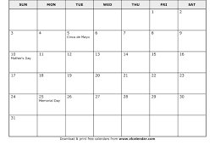
Return to Work – Time Based
Time-based strategy excludes an employee from returning to work until at least 10 days have passed since the date of their first positive COVID-19 diagnostic test assuming they have not subsequently developed symptoms since their positive test.
If they develop symptoms, then the symptom-based or test-based strategy shall be used.

Slide 53
Return to Work - Test Based
Test-based strategy excludes an employee from returning to work until negative results of an FDA Emergency Use Authorized COVID-19 molecular assay for detection of SARS-CoV-2 RNA from at least two consecutive respiratory specimens collected ≥24 hours apart (total of two negative specimens).
If a known to be infected with SARS-CoV-2 asymptomatic employee refuses to be tested, employer compliance with §16VAC25-220-40.B.2.a, time-based strategy, will be considered in compliance with this standard.
Nothing in this standard shall be construed to prohibit an employer from requiring a known to be infected asymptomatic employee to be tested in accordance with §16VAC25-220-40.B.2.b.
For purposes of this section, COVID-19 testing is considered a “medical examination” under Va. Code §40.1-28.49. The employer shall not require the employee to pay for the cost of COVID-19 testing for return to work determinations.

Slide 54
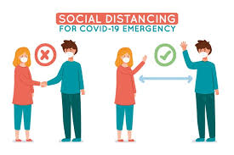
§40 C. Physical Distancing
Unless otherwise provided in this standard, employers shall ensure that employees observe physical distancing while on the job and during paid breaks on the employer’s property, including policies and procedures that:
Use verbal announcements, signage, or visual cues to promote physical distancing;
Decrease worksite density by limiting non-employee access to the place of employment or restricted access to only certain workplace areas to reduce the risk of exposure.
An employer’s compliance with occupancy limits contained in any applicable Virginia executive order or order of public health emergency will constitute compliance with the requirement.

Slide 55
Common Areas - Physical Distancing
Access to common areas, breakrooms or lunchrooms shall be closed or controlled.
If a work area does not allow employees to consume meals in the employee’s workspace while observing physical distancing, an employer may designate, reconfigure, and alternate usage of spaces where employees congregate, including lunch and break rooms, locker rooms, time clocks, etc., with controlled access, provided the following conditions are met:

Slide 56


Common Areas - PhysicalDistancing
At the entrance(s) of the designated common area or room the employer shall clearly post:
The policy limiting the occupancy of the space;
The requirements for physical distancing;
The requirements for hand washing/hand sanitizing; and
Cleaning and disinfecting of shared surfaces.
The employer shall limit occupancy of the designated common area or room so that occupants maintain physical distancing from each other. The employer shall enforce the occupancy limit.
Notes:
Page 20

Slide 57
Common Areas-Physical Distancing
Employees shall be required to clean and disinfect the immediate area in which they were located prior to leaving or the employer may provide for cleaning and disinfecting of the common area or room at regular intervals throughout the day, and between shifts of employees using the same common area or room.
Hand washing facilities, and hand sanitizer where feasible, are available to employees.
Hand sanitizers required for use to protect against SARS-CoV-2 are FLAMMABLE and use and storage in hot environments can result in a hazard.
When multiple employees are occupying a vehicle for work purposes, the employer shall ensure compliance with respiratory protection & PPE standards applicable to its industry.
Employers shall ensure compliance with mandatory requirements of any applicable executive order or order of public health emergency

Slide 58
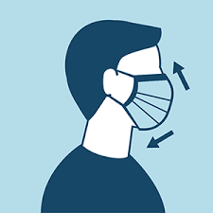
Physical Distancing – Face Covering Information
If the work area does not allow employees to observe physical distancing requirements, employers shall ensure compliance with respiratory protection and personal protective equipment applicable to its industry.
Employers shall also ensure compliance with mandatory requirements of any applicable Virginia executive order or order of public health emergency.
Nothing in this section shall require the use of a respirator, surgical/medical procedure mask, or face covering by any employee for whom doing so would be contrary to their health or safety because of a medical condition; however, nothing in this standard shall negate an employer’s obligations to comply with personal protective equipment and respiratory protection standards applicable to its industry.

Slide 59
Physical Distancing – Face Covering Waiver
Requests to the Department of Labor and Industry for religious waivers from the required use of respirators, surgical/medical procedure masks, or face coverings will be handled in accordance with the requirements of applicable federal and state law, standards, regulations and the U.S. and Virginia Constitutions, after consultation with the Office of the Attorney General

Slide 60

Sanitation and Disinfecting
In addition to the requirements in this standard, employers shall comply with VOSH sanitation applicable to its industry.
Employees that interact with customers, the general public, contractors, etc., shall be provided with and immediately use supplies to clean and disinfectant surfaces contacted during the interaction where there is the potential for exposure to SARS-CoV-2 virus by themselves or other employees.
All employers must comply with the hazard communication standard

Slide 61



Sanitation & Disinfecting
Areas where known or suspected to be infected with SARS-CoV-2 virus employees or other persons accessed or worked shall be cleaned and disinfected prior to allowing other employees to access the area . Where feasible, a period of 24 hours will be observed prior to cleaning and disinfecting. This requirement shall not apply if the area(s) in question have been unoccupied for seven or more days.
All common spaces, including bathrooms, frequently touched surfaces and doors, shall at a minimum be cleaned and disinfected at the end of each shift.
All Shared tools, equipment, workspaces, and vehicles shall be cleaned and disinfected prior to transfer from one employee to another.

Slide 62
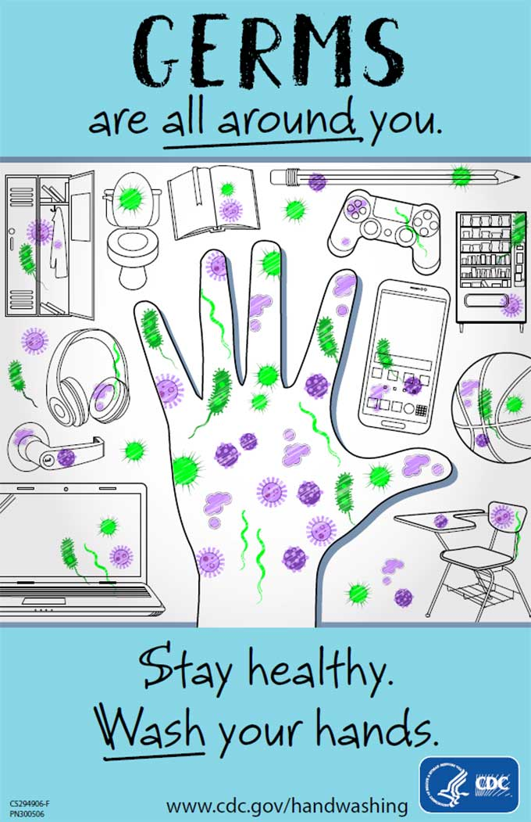
Sanitation & Disinfecting
Employers shall ensure that cleaning and disinfecting products are readily available to employees to accomplish the required cleaning and disinfecting.
Employers shall ensure use of only disinfecting chemicals and products indicated in the Environmental Protection Act (EPA) List N for use against SARS-CoV-2 and emerging viral pathogens.
Follow the manufacturer’s instructions for use of all disinfecting chemicals and products are complied with.
https://www.epa.gov/pesticide-registration/list-n-disinfectants-use-against-sars-cov-2-covid-19

Slide 63

Sanitation & Disinfecting
Employees shall have easy, frequent access, and permission to use soap and water and hand sanitizer where feasible, for the duration of work.
Employees assigned to a workstation where job tasks require frequent interaction inside six feet with other persons shall be provided with hand sanitizer where feasible at their workstation.
Mobile crews shall be provided with hand sanitizer where feasible for the duration of work at a work site and shall have transportation immediately available to nearby toilet facilities and handwashing facilities which meet the requirements of VOSH laws, standards and regulations dealing with sanitation.

Slide 64
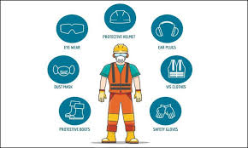
Sanitation & Disinfecting
Employers shall ensure that protective measures are put in place to prevent employees from cross-contaminating work areas operating under different exposure risk classifications.
When engineering, work practice, and administrative controls are not feasible or provide sufficient protection, employers shall provide PPE and ensure its proper use.

Slide 65
§50 Very High or High Exposure Risk Requirements
Very High
High
The following requirements for employers with hazards or job tasks classified as “very high” or “high” exposure risk apply in addition to requirements contained in §§16VAC25-220-40, -70, and -80
Notes:
Page 30

Slide 66
Very High or High Exposure Risk Requirements
Engineering Controls
§16VAC25-220-50.A.1. Ensure appropriate air-handling systems are installed and maintained in accordance with manufacturer’s instructions in healthcare facilities and other places of employment treating, caring for, or housing persons with known or suspected to be infected with the SARS-CoV-2 virus.

Slide 67
Very High or High Exposure Risk Requirements
Engineering Controls (cont.)
Comply with minimum American National Standards Institute (ANSI)/American Society of Heating, Refrigerating and Air-Conditioning Engineers (ASHRAE) Standards 62.1 and 62.2 (ASHRAE 2019a, 2019b).
For employers not covered by §16VAC25-220-50.A.1, ensure that air-handling systems where installed are appropriate to address the SARS-CoV-2 and COVID-19 related hazards and job tasks that occur at the workplace:
Maintained as per manufacturer’s instructions,
Comply with §16VAC25-220-50.A.1.b. (ANSI and ASHRAE Standards).

Slide 68
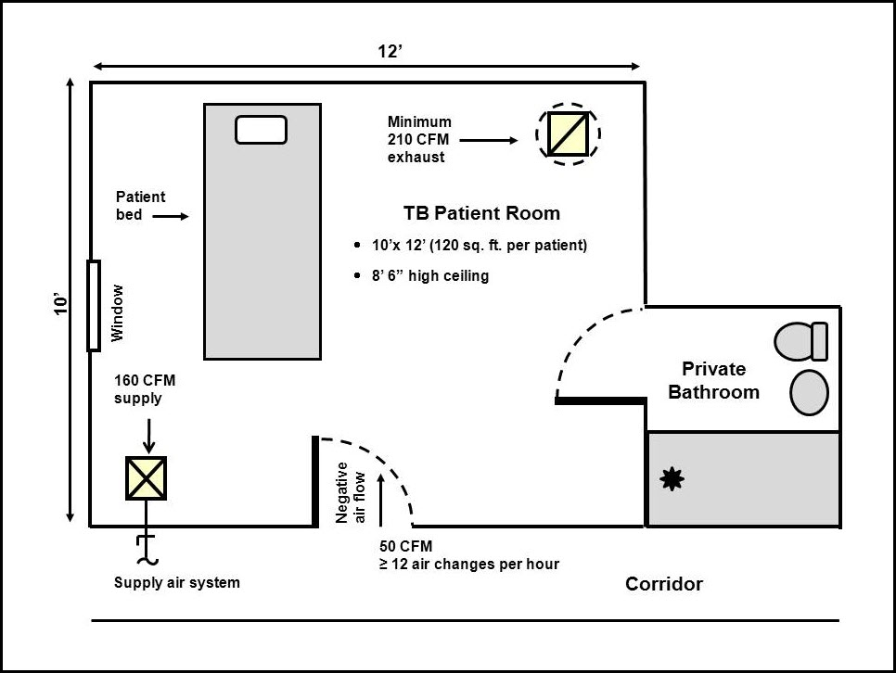
Very High or High Exposure Risk Requirements
Engineering Controls
Hospitalized patients with known or suspected to be infected shall, where feasible and available, be placed in an airborne infection isolation room (AIIR).
Use AIIR rooms when available to perform aerosol-generating procedures on known or suspected to be infected.
Notes:
Where feasible and available

Slide 69
Very High or High Exposure Risk Requirements
Engineering Controls
For postmortem activities, employers shall use autopsy suites or other similar isolation facilities when performing aerosol-generating procedures on the bodies of known or suspected to be infected persons at the time of their death.
Notes:
Where feasible and available

Slide 70
Very High or High Exposure Risk Requirements
Engineering Controls (cont.)
Use special precautions associated with Biosafety Level 3 (BSL-3), as defined by the U.S. Department of Health and Human Services Publication No. (CDC) 21-1112 “Biosafety in Microbiological and Biomedical Laboratories” (Dec. 2009), which is hereby incorporated by reference, when handling specimens from known or suspected to be infected patients or persons.
Notes:
Where feasible and available

Slide 71
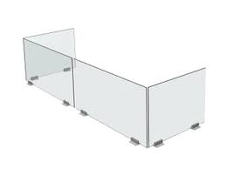
Very High or High Exposure Risk Requirements
Engineering Controls
To the extent feasible, employers shall install physical barriers, (e.g. clear plastic sneeze guards, etc.) where such barriers will aid in mitigating the spread of SARS-CoV-2 and COVID-19 virus transmission.
Notes:
Where feasible and available

Slide 72
Very High or High Exposure Risk Requirements
Administrative & Work Practice Controls
Prior to the commencement of each work shift, prescreening or survey shall be required to verify each covered employee does not have signs or symptoms of COVID-19.

Slide 73
Very High or High Exposure Risk Requirements
Administrative & Work Practice Controls (cont.)
If working in a healthcare facility, follow existing guidelines and facility standards of practice for identifying and isolating infected persons and for protecting employees.

Slide 74
Very High or High Exposure Risk Requirements
Administrative & Work Practice Controls (cont.)
Limit non-employee access to the place of employment or restrict access to only certain workplace areas to reduce the risk of exposure. An employer’s compliance with occupancy limits contained in any Virginia executive order or order of public health emergency will constitute compliance with the requirements of this paragraph.

Slide 75
Very High or High Exposure Risk Requirements
Administrative & Work Practice Controls
Post signs requesting patients and family members to immediately report symptoms of respiratory illness on arrival at the healthcare facility and use disposable face masks.

Slide 76
Very High or High Exposure Risk Requirements
Administrative & Work Practice Controls
Offer enhanced medical monitoring of employees during outbreaks.
Provide all employees with job-specific education and training on preventing transmission of COVID-19, including initial and routine/refresher training in accordance with §16VAC25-220-80.

Slide 77
Very High or High Exposure Risk Requirements
Administrative & Work Practice Controls
To the extent feasible, ensure that psychological and behavioral support is available to address employee stress at no cost to the employees.
I

Slide 78
Very High or High Exposure Risk Requirements
Administrative & Work Practice Controls
In health care settings, provide alcohol-based hand sanitizers containing at least 60% ethanol or 70% isopropanol to employees at fixed work sites and to emergency responders and other personnel for decontamination in the field when working away from fixed work sites.
Provide face coverings to suspected to be infected SARS-CoV-2 virus non-employees until they are able to leave the site.

Slide 79
Very High or High Exposure Risk Requirements
Administrative & Work Practice Controls
Where Feasible:
Implement flexible worksites / hours – telework, staggered shifts;
Physical distancing for employees and other persons of 6 feet;
Limit number of non-employee accessing worksites;
Flex meeting and travel options (phone, video, no non-essential travel);
Deliver services remotely, curbside pickup.

Slide 80
Very High or High Exposure Risk Requirements
Personal Protective Equipment (PPE)
Employers not otherwise covered by the VOSH Standards for General Industry (Part 1910), shall comply with the following requirements for a SARS-CoV-2 virus and COVID-19 disease hazard assessment, and personal protective equipment.
The employer shall assess the workplace to determine if hazards or job tasks are present, or are likely to be present, which necessitate the use of personal protective equipment (PPE).
The employer shall provide for employee and employee representative involvement in the assessment process.

Slide 81
Very High or High Exposure Risk Requirements
Personal Protective Equipment (PPE)
If such hazards or job tasks are present, or likely to be present, the employer shall:
Select, and have each affected employee use, the types of PPE that will protect the affected employee from the hazards identified in the hazard assessment;
Communicate selection decisions to each affected employee; and,
Select PPE that properly fits each affected employee.
Assessment
Job Task
Hazards Present
Hazards Likely to be Present
No Hazards
PPE Needed
PPE Needed

Slide 82
Very High or High Exposure Risk Requirements
Personal Protective Equipment (PPE)
The employer shall verify that the required SARS-CoV-2 virus and COVID-19 disease workplace hazard assessment has been performed through a written certification that identifies the workplace evaluated; the person certifying that the evaluation has been performed; the date(s) of the hazard assessment; and, the document as a certification of hazard assessment.
Unless specifically addressed by an industry specific standard applicable to the employer and providing for PPE protections to employees from the SARS-CoV-2 virus or COVID-19 disease (e.g., Parts 1926, 1928, 1915, 1917, or 1918), the requirements of §1910.132 (General requirements) and 1910.134 (Respiratory protection) shall apply to all employers for that purpose.

Slide 83
Very High or High Exposure Risk Requirements
Personal Protective Equipment (PPE)
The employer shall implement a respiratory protection program in accordance with §1910.134 (b) through (d) (except (d)(1)(iii)), and (f) through (m), which covers each employee required to use a respirator.
Unless contraindicated by a hazard assessment and equipment selection requirements in §16VAC25-220-50.C.1 above, employees classified as very high or high exposure risk shall be provided with and wear gloves, a gown, a face shield or goggles, and a respirator, when in contact with or inside 6 feet of patients, persons know to be, or suspected of being infected with SARS-CoV-2.
Notes:
Training is covered later in presentation

Slide 84
Very High or High Exposure Risk Requirements
Personal Protective Equipment (PPE)
Where indicated by the hazard assessment and equipment selection requirements in §16VAC25-220-50.C, such employees shall also be provided with and wear a surgical/medical procedure mask.
Gowns shall be large enough to cover areas requiring protection.
Employee training shall be provided in accordance with the requirements of §16VAC25-220-80 of this regulation/standard.
Notes:
Training is covered later in presentation

Slide 85
§60 Medium Exposure Risk Requirements
The following requirements for employers with hazards or job tasks classified as “medium” exposure risk apply in addition to requirements contained in §§16VAC25-220-40, -70, and -80.
Medium

Slide 86
§60 Medium Exposure Risk Requirements
Engineering Controls
Ensure air-handling systems where installed are appropriate to address the SARS-CoV-2 virus and COVID-19 disease related hazards and job tasks that occur at the workplace:
Are maintained in accordance with manufacturer’s instructions,
Comply with minimum American National Standards Institute (ANSI)/American Society of Heating, Refrigerating and Air-Conditioning Engineers (ASHRAE) Standards 62.1 and 62.2 (ASHRAE 2019a, 2019b), which include requirements for outdoor air ventilation in most residential and nonresidential spaces, and
ANSI/ASHRAE/ASHE Standard 170 (ASHRAE 2017a) covers both outdoor and total air ventilation in healthcare facilities.
Based on risk assessments or owner project requirements, designers of new and existing facilities can go beyond the minimum requirements of these standards.

Slide 87
Medium Exposure Risk Requirements
Administrative and Work Practice Controls
To the extent feasible, employers shall implement the following administrative and work practice controls:
Prior to the commencement of each work shift, prescreening or surveying shall be required to verify each covered employee does not have signs or symptoms of COVID-19.
Provide face coverings to suspected to be infected with SARS-CoV-2 non-employees to contain respiratory secretions until they are able to leave the site (i.e., for medical evaluation/care or to return home).

Slide 88
Medium Exposure Risk Requirements
Administrative & Work Practice Controls
Implement flexible worksites / hours – telework, staggered shifts;
Physical distancing for employees and other persons of 6 feet;
Limit number of non-employee accessing worksites;
To the extent feasible, employers shall install physical barriers (e.g., clear plastic sneeze guards, etc.), where such barriers will aid in mitigating the spread of SARS-CoV-2 virus transmission;
Flex meeting and travel options (phone, video, no non-essential travel);
Deliver services remotely, curbside pickup;

Slide 89

Medium Exposure Risk Requirements
Administrative & Work Practice Controls
Require employers to provide and employees to wear face coverings who, because of job tasks cannot feasibly practice physical distancing from another employee or other person if the hazard assessment has determined that personal protective equipment, such as respirators or surgical masks, was not required for the job task.
Require employers to provide and employees in customer facing jobs to wear face coverings.

Slide 90
Medium Exposure Risk Requirements
Personal Protective Equipment (PPE)
Employers covered by this section and not otherwise covered by the VOSH Standards for General Industry (Part 1910), shall comply with the following requirements for a SARS-CoV-2 virus and COVID-19 disease related hazard assessment, and personal protective equipment selection:
Assess the workplace to determine if SAS-CoV-2 or COVID-19 hazards or job tasks are present, likely to be present which requires use of PPE. The employer shall provide for employee and employee representative involvement in the assessment process. If hazard or task are present, or likely to be present, the employer shall:
Select and require affected employees use proper PPE;
Communicate selection decisions to each affected employee; and,
Select PPE that properly fits each affected employee.

Slide 91
Medium Exposure Risk Requirements
Personal Protective Equipment (PPE)
Employers covered by this section and not otherwise covered by the VOSH Standards for General Industry (Part 1910), shall comply with the following requirements for a SARS-CoV-2 virus and COVID-19 disease related hazard assessment, and personal protective equipment selection:
Assess the workplace to determine if SAS-CoV-2 or COVID-19 hazards or job tasks are present, likely to be present which requires use of PPE. The employer shall provide for employee and employee representative involvement in the assessment process. If hazard or task are present, or likely to be present, the employer shall:
Select and require affected employees use proper PPE;
Communicate selection decisions to each affected employee; and,
Select PPE that properly fits each affected employee.

Slide 92

§70 Infectious Disease Preparedness & Response Plan
Employers in exposure risk levels very high, and high, shall develop and implement a written Infectious Disease Preparedness and Response Plan.
Medium with 11 or more employees shall develop and implement a written Infectious Disease Preparedness and Response Plan.
The plan and training requirements tied to the plan shall only apply to those employees classified as “very high,” “high,” and “medium” covered by this section.
Employers shall designate a person to be responsible for implementing their plan.

Slide 93
Infectious Disease Preparedness & Response Plan
The plan shall contain:
The name(s) or titles(s) of the person(s) responsible for administering the Plan. This person shall be knowledgeable in infection control principles and practices as they apply to the facility, service or operation.
Provide for employee involvement in development and implementation of the plan.
Consider and address the level(s) of risk associated with various places of employment, the hazards employee are exposed to and job tasks employees perform at those sites.

Slide 94
Infectious Disease Preparedness & Response Plan
The plan shall contain:
Where, how, and to what sources of SARS-CoV-2 or COVID-19 might employees be exposed at work, including:
The general public, customers, other employees, patients, and other persons;
Known or suspected to be infected persons or those at high risk; and
Situations where employees work more than one job with different employers and encounter hazards or engage in job task that present a “very high,” “high,” or “medium” level of exposure risk.
As permitted by law, including HIPPA, employees’ individual risk factors
Engineering, administrative, work practices, and personal protective equipment controls necessary to address those risks.

Slide 95
Infectious Disease Preparedness & Response Plan
The plan shall contain:
Consider contingency plans for situations that may arise as a result of outbreaks, such as:
Increased rates of employee absenteeism;
The need for physical distancing, staggered work shifts, downsizing operations, delivering services remotely, and other exposure-reducing workplace control measures such as elimination/substitution, engineering controls, administrative and work practice controls, personal protective equipment, e.g., respirators, surgical/medical procedure masks, etc.
Options for conducting essential operations with a reduced workforce, including cross-training employees across different jobs in order to continue operations or deliver surge services; and
Interrupted supply chains or delayed deliveries.

Slide 96
Infectious Disease Preparedness & Response Plan
The plan shall contain:
Identify Basic infection prevention measures to be implemented:
Promote frequent and thorough hand washing, including by providing employees, customers, visitors, the general public, to the place of employment with a place to wash their hands. If soap and running water are not immediately available, provide hand sanitizers.
Maintain regular housekeeping practices, including routine cleaning and disinfecting of surfaces, equipment, and other elements of the work environment.
Establish policies and procedures for managing and educating visitors to the place of employment.

Slide 97
Infectious Disease Preparedness & Response Plan
The plan shall contain:
Provide for the prompt identification and isolation of known or suspected to be infected with SARS-CoV-2 employees away from work, including procedures for employees to report when they are experiencing symptoms of COVID-19.
Address Infectious disease preparedness and response with outside businesses, including but not limited to subcontractors that enter the place of employment, business that provide or contract or temporary employees to the employer, as well as other persons accessing the place of employment to comply with the requirements of this standard and the employer’s plan.

Slide 98
Infectious Disease Preparedness & Response Plan
The plan shall contain:
Identify the mandatory and non-mandatory recommendations in any CDC guidelines or Commonwealth of Virginia guidance documents the employer is complying with, if any, in lieu of a provision of this standard, as provided for in section §§16VAC25-220-10.G.1 and -10.G.2.
Ensure compliance with mandatory requirements of any applicable Virginia executive order or order of public health emergency related to the SARS-CoV-2 virus or COVID-19 disease.

Slide 99
§80 Training
Employers with hazards or job tasks classified at “very high”, “high” or “medium” exposure risk at a place of employment shall provide training to all employee(s) working at the place of employment regardless of employee risk classification on the hazards and characteristics of the SARS-CoV-2 virus and COVID-19 disease.
The program shall enable each employee to recognize the hazards of SARS-CoV-2 virus and signs and symptoms of COVID-19 disease and shall train each employee in the procedures to be followed in order to minimize the hazards.

Slide 100
Training
Training required includes:
The requirements of this standard;
The mandatory and non-mandatory recommendations in any CDC guidelines or State of Virginia guidance documents the employer is complying with, if any, in lieu of a provision of this standard as provided for in section §§16VAC25-220-10.G.1 and -10.G.2.
The characteristics and methods of spread of the SARS-CoV-2 virus;
The signs and symptoms of the COVID-19 disease;
Risk factors of severe COVID-19 illness with underlying health conditions;
Awareness of the ability of pre-symptomatic and asymptomatic COVID-19 persons to transmit the SARS-CoV-2 virus;
Safe and healthy work practices including:
physical distancing, disinfection procedures and frequency, ventilation, noncontact methods of greeting, etc.,

Slide 101
Training
PPE:
When PPE is required;
What PPE is required;
How to properly don, doff, adjust, and wear PPE;
The limitations of PPE;
The proper care, maintenance, useful life, and disposal of PPE; and
Heat-related illness prevention including the signs and symptoms of heat-related illness;
The anti-discrimination provisions of the Standard in §16VAC25-220-90; and
The employer’s Infectious Disease Preparedness and Response Plan.

Slide 102
Training - Certification
Employers covered by §16VAC25-220-50 of this standard shall verify compliance with §16VAC25-220-80.A by preparing a written certification record for those employees exposed to hazards or job tasks classified at “very high,” “high,” or “medium” exposure risk levels.
The written certification record shall contain the name or other unique identifier of the employee trained, the trained employee’s physical or electronic signature, the date(s) of the training, and the name of the person who conducted the training, or for computer-based training, the name of the person or entity that prepared the training material.

Slide 103
Training - Certification
If the employer relies on training conducted by another employer or completed prior to the effective date of this standard, the certification record shall indicate the date the employer determined the prior training was adequate rather than the date of actual training.
The latest training certification shall be maintained.

Slide 104
Training - Retraining
Retraining –
When employer has reason to believe that any affected employee who has already been trained does not have the understanding and skill required by §16VAC25-220-80.A, the employer shall retrain each such employee.
Circumstances where retraining is required include, but are not limited to:
Changes in workplace, SARS-CoV-2 or COVID-19 disease hazards exposed to, or job task performed render previous training obsolete;
Changes are made to the employer’s Infectious Disease Preparedness and Response Plan; or
Inadequacies in an affected employee’s knowledge or use of workplace control measures indicate that the employee has not retained the required understanding or skill.

Slide 105
Training – “Lower” exposure
Employers with hazards or job tasks classified at “lower” risk shall provide written or oral information to employees exposed to such hazards or engaged in in such job tasks on the hazards and characteristics of SARS-CoV-2 and the symptoms of COVID-19 and measures to minimize exposure.
The Department of Labor and Industry shall develop an information sheet containing information which an employer may utilize to comply with this section.

Slide 106
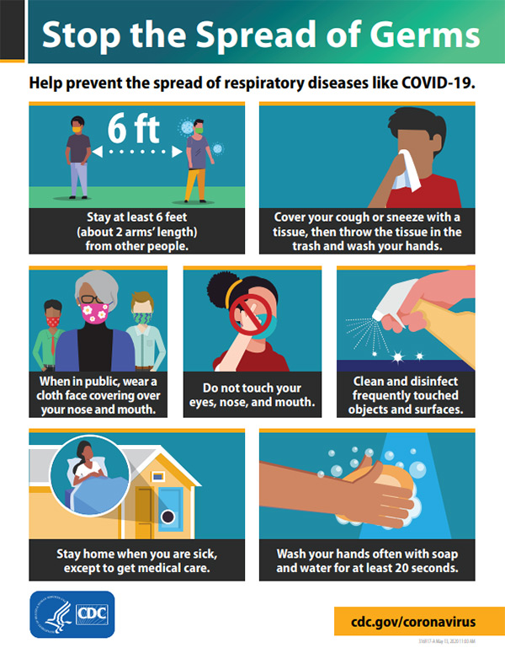
Information Provided for “Lower” exposure
The information shall include at a minimum:
Requirements of this standard,
Characteristics and methods of transmission of the SARS-VoV-2 virus,
Symptoms of the COVID-19 disease,
Ability of pre-symptomatic and asymptomatic COVID-19 persons to transmit the SARS-CoV-2 virus,
Safe and Healthy work practices and control measures, including but not limited to, physical distancing, sanitation and disinfection practices, and
The anti-discrimination provisions of this standard in §16VAC25-220-90.

Slide 107
§90 Discrimination
Discrimination against an employee for exercising rights under this standard is prohibited.
No person shall discharge or in any way discriminate against an employee because the employee has exercised rights under the safety and health provisions of this standard or Title 40.1 of the Code of Virginia, and implementing regulations under 16VAC25-60-110 for themselves or others.
No person shall discharge or in any way discriminate against an employee who voluntarily provides and wears his or her own personal protective equipment, including but not limited to a respirator, face shield, or gloves, or face covering if such equipment is not provided by the employer, provided that the PPE does not create a greater hazard to the employee, or create a serious hazard for other employees.

Slide 108
§90 Discrimination
No person shall discharge or in any way discriminate against an employee who raises a reasonable concern about infection control related to the SARS-CoV-2 virus and COVID-19 disease to the employer, the employer’s agent, other employees, a government agency, or to the public such as through print, online, social, or any other media.
Nothing in this standard shall limit an employee from refusing to do work or enter a location they feel is unsafe. See §16VAC25-60-110 for requirements concerning discharge or discipline of an employee who has refused to complete an assigned task because of a reasonable fear of injury or death.

Slide 109
Question or Need More Information?
VOSH Consultation Services are here to help you:
To request a FREE, CONFIDENTIAL Onsite or Virtual Visit by our qualified consultants visit our website and complete the Consultation Request Form
https://www.doli.virginia.gov/vosh-programs/consultation/
We offer Hazard Identification, Training, Abatement Advice, Program Assistance, and Industrial Hygiene Sampling

